Slide 1
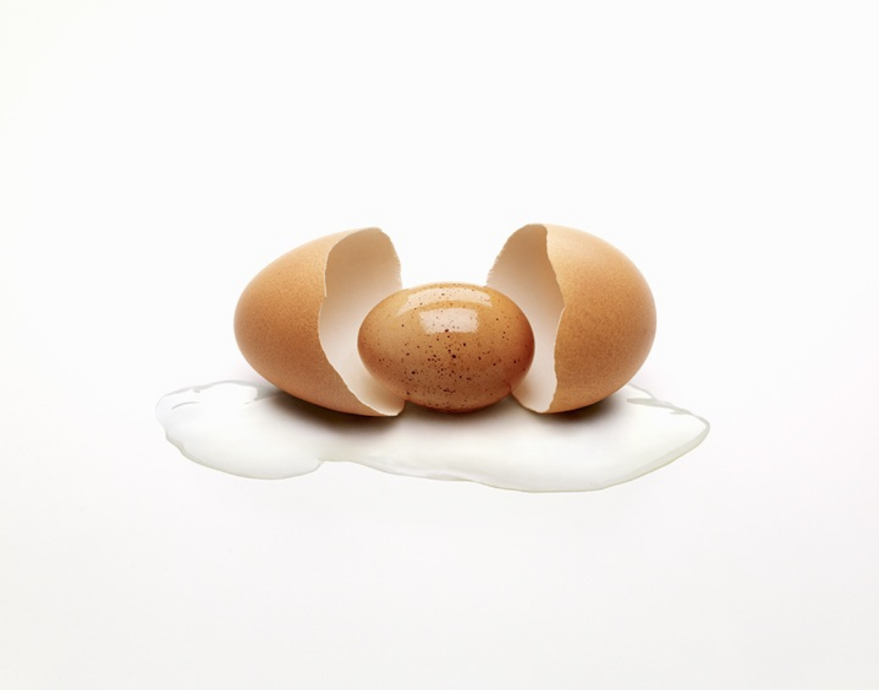
Intentional Living

Slide 2
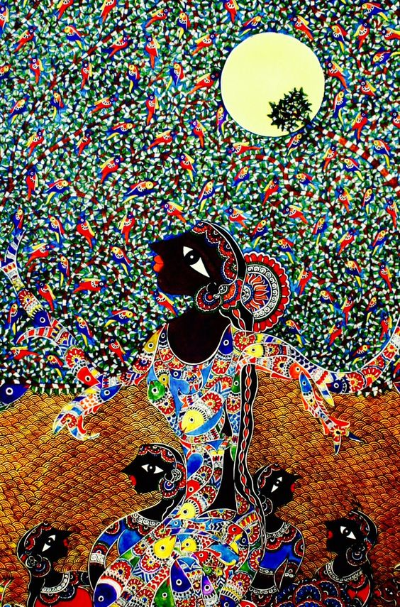
Fresh Eyes

Slide 3
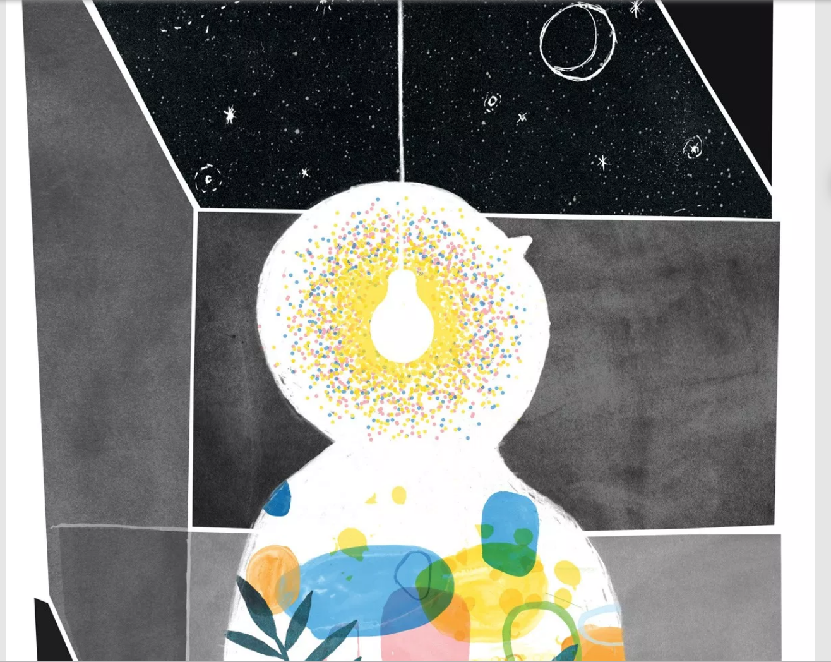
Fresh Mind

Slide 4
Fresh Heart

Slide 5
The fruits

